Slide 1
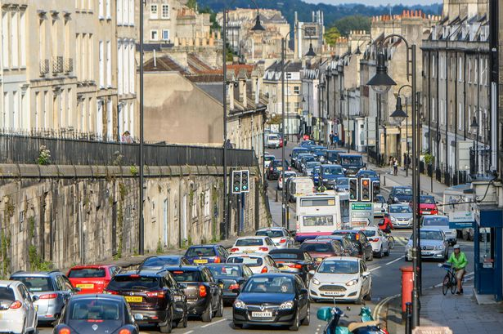

Slide 2
Home task: Write an essay
“What are we going to do with all this litter?”

Slide 3
Tasks for the lesson
1 revise words about Litter Problem
2 discuss the ideas of solving litter problems
3 revise the plan of the essay

Slide 4
WB ex1 p48
IDEAS | RESULTS
1. To make the destruction of animals’ habitats illegal and fine people for that | It would discourage people from committing such acts
2. To encourage people not to buy animal products | Manufactures would produce fewer products made with the fur, skin or teeth of endangered animals
3. To create more national parks and protected habitats for endangered animals | Their number would increase and the species would not disappear

Slide 5
LINKERS
To introduce suggestions – to start with, another solution would be
To express effect – thus, as a result, therefore
To conclude – to sum up

Slide 6
Home task: Write an essay
“What are we going to do with all this litter?”

Slide 7
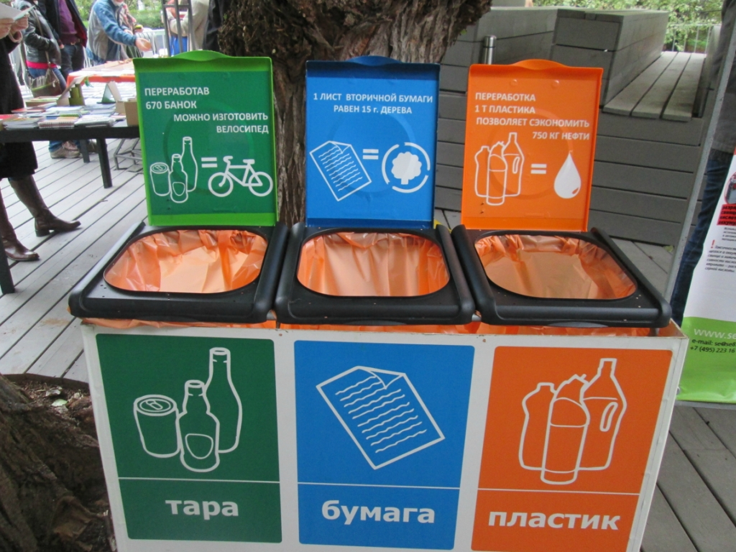
Sort litter

Slide 8
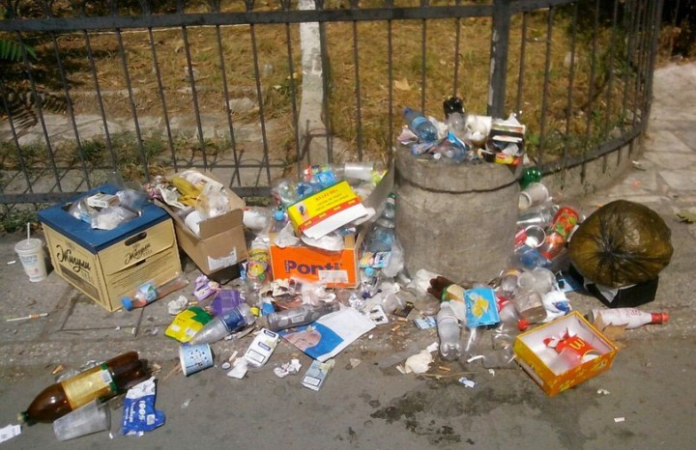
Put more litter-bins

Slide 9
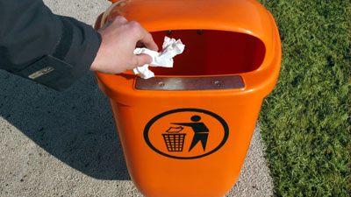
Put litter only into litter-bins

Slide 10
Where is the essay scheme?
A B
_________
_________
______
____________________
____________________
_____________________
_______
_______
____________
_________________
____________________
_________________
____________________
__________________
____________________
__________________
____________________

Slide 11
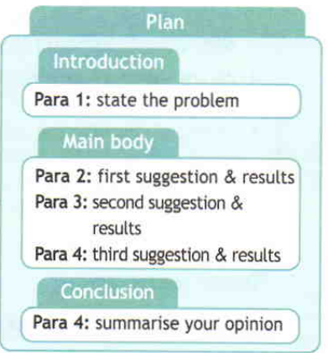

Slide 12
Home task:
Write an essay
“What are we going to do with all this litter?”

